Slide 1
Hound Group

Slide 2
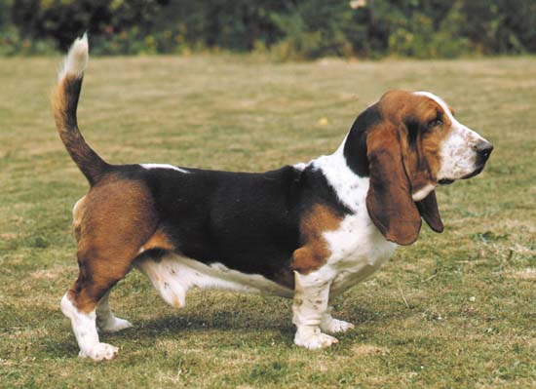
Basset Hound

Slide 3
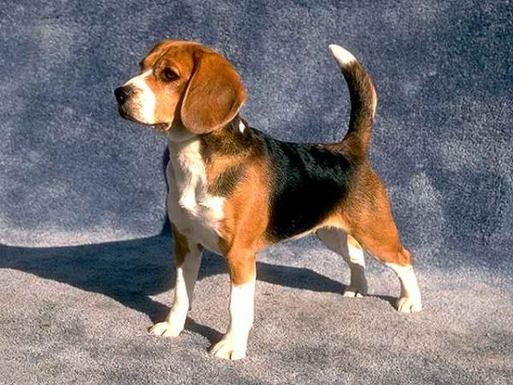
Beagle

Slide 4
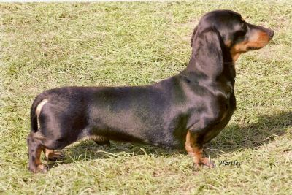
Dacshund

Slide 5
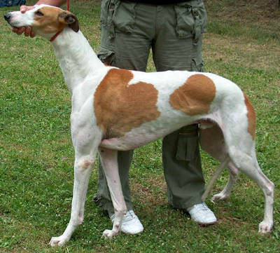
Greyhound

Slide 6
Herding Group

Slide 7
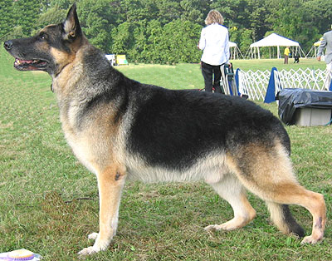
German Shepard

Slide 8
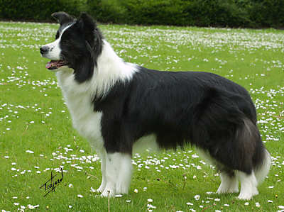
Border Collie

Slide 9
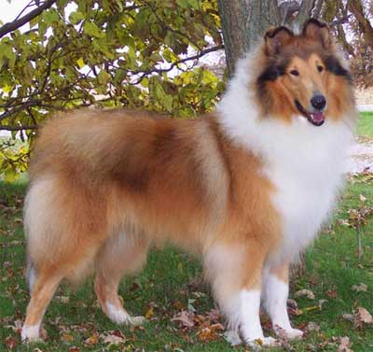
Collie

Slide 10
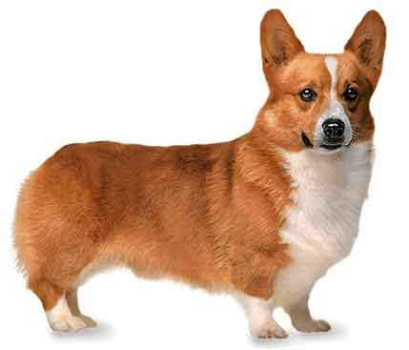
Pembroke Welsh Corgi

Slide 11
Working Group

Slide 12
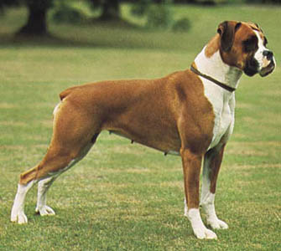
Boxer

Slide 13
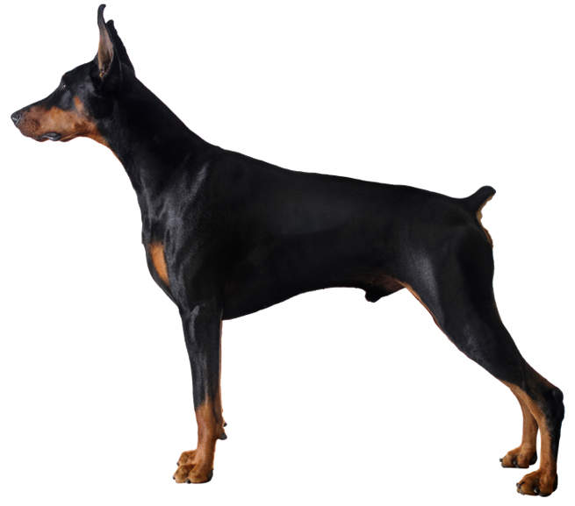
Doberman

Slide 14
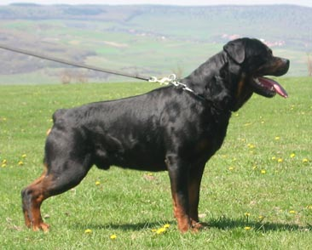
Rottweiler

Slide 15
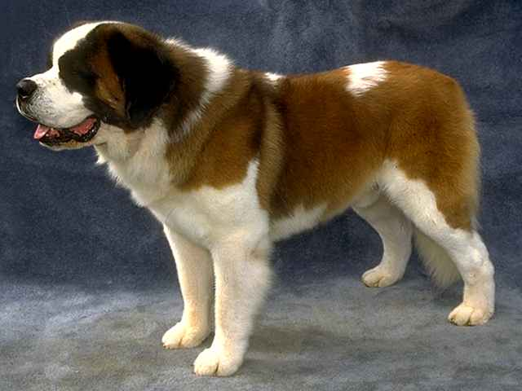
Saint Bernard

Slide 16
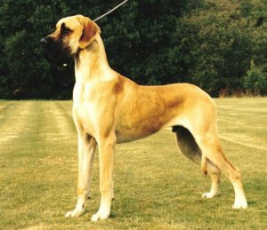
Great Dane

Slide 17
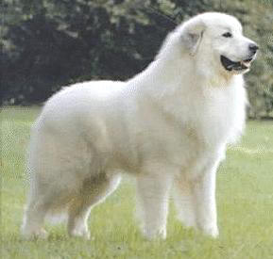
Great Pyrenees

Slide 18
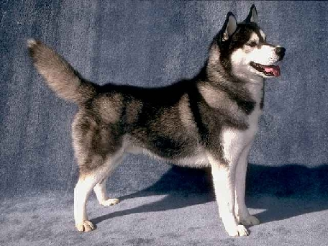
Siberian Husky

