Slide 1
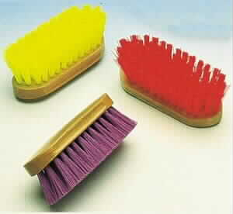
Dandy Brush

Slide 2
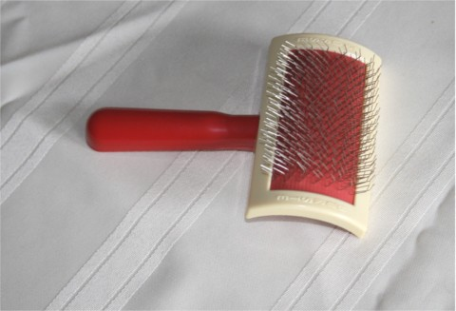
Slicker Brush

Slide 3
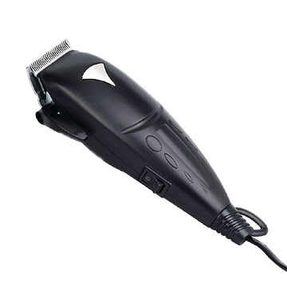
Clippers

Slide 4
Curry Comb

Slide 5
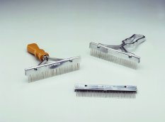
Scotch Comb

Slide 6
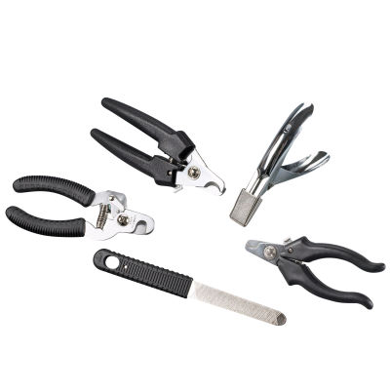
Nail Trimmers

Slide 7
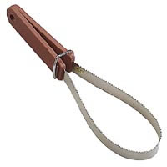
Shedding Blade

Slide 8
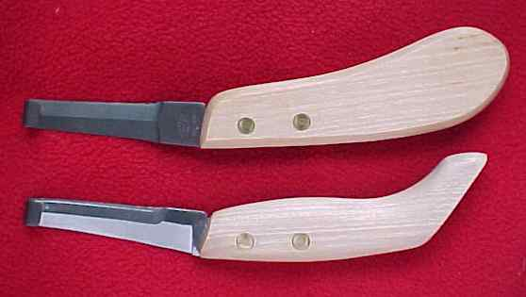
Hoof Knife

Slide 9
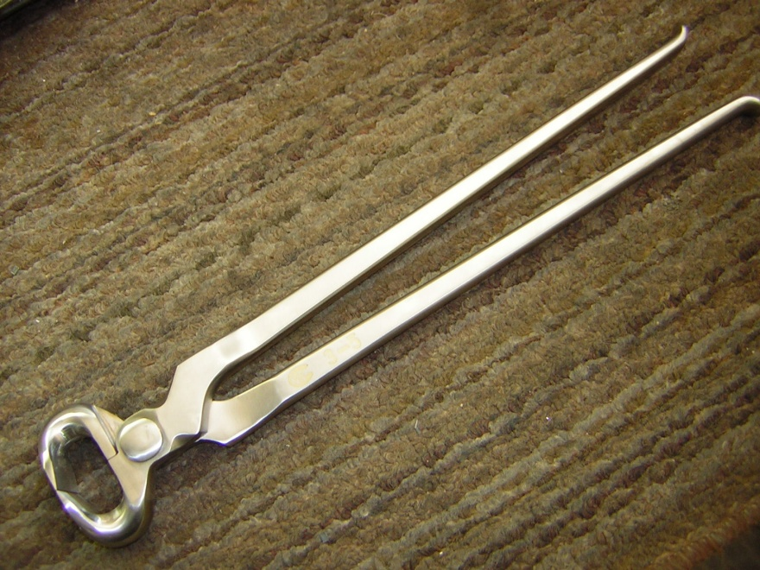
Hoof Nipper

Slide 10
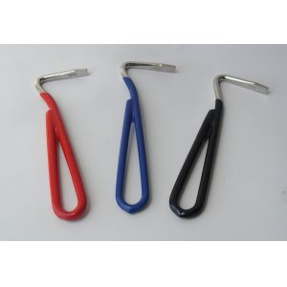
Hoof Pick

Slide 11
Hoof Rasp

Slide 12
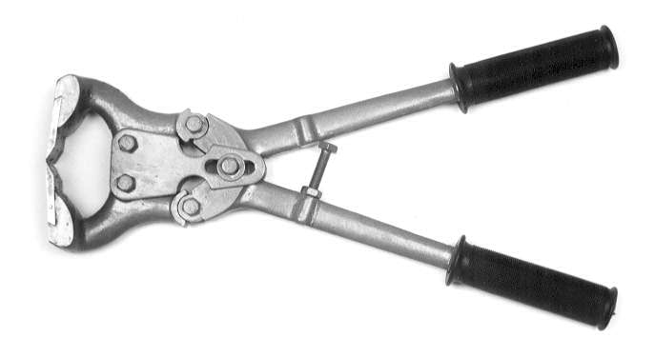
Hoof Trimmers

Slide 13
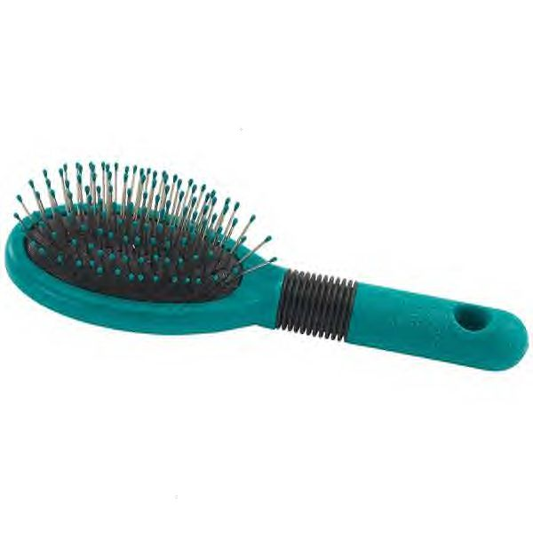
Pin Brush

Slide 14
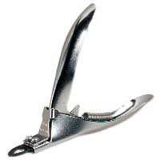
Gulitine Nail Clippers

Slide 15
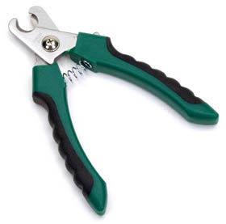
Plier Nail Clippers

