Slide 1
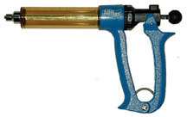
Automatic Syringe Revolver

Slide 2
Balling Gun

Slide 3
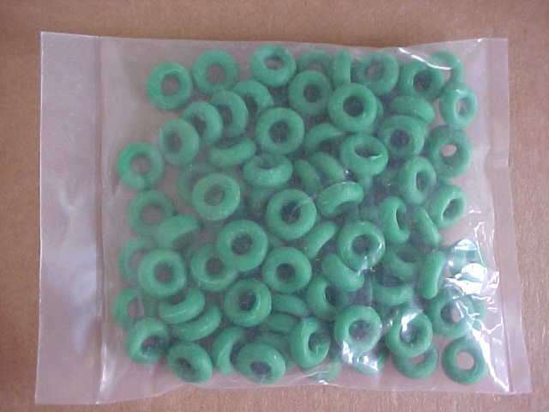
Bands (Elastrator)

Slide 4
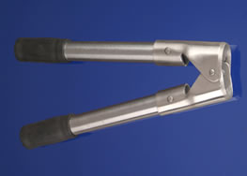
Barnes Dehorner

Slide 5
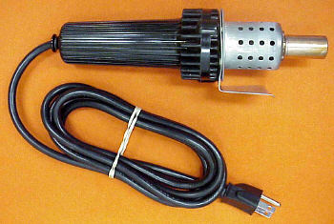
Electric Dehorner

Slide 6
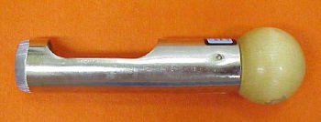
Scoop or Tube Dehorner

Slide 7
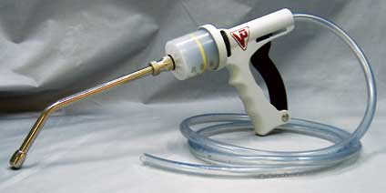
Drench Gun

Slide 8
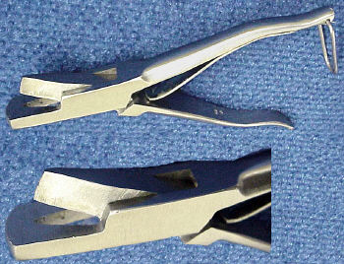
Ear Notcher

Slide 9
Ear Tag

Slide 10
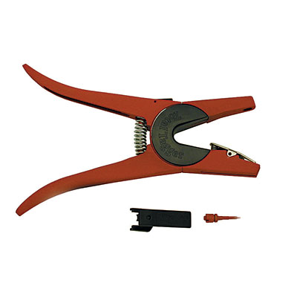
Ear Tag Pliers

Slide 11
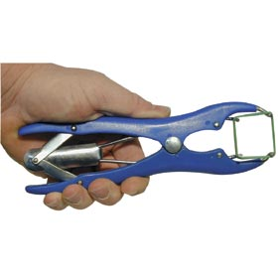
Elastrator

Slide 12
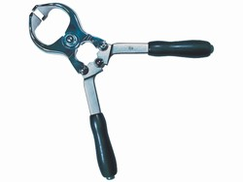
Emasculators

Slide 13
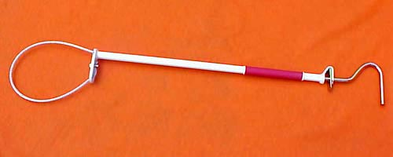
Hog Snare

Slide 14
Obstetrical Chain and Handle

Slide 15
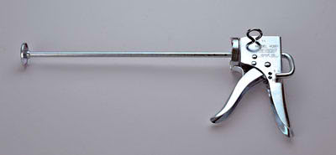
Paste Gun

Slide 16
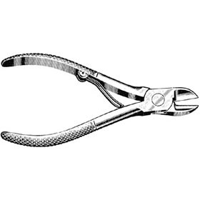
Pig Tooth Nippers

Slide 17
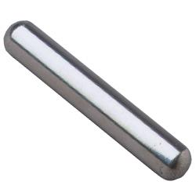
Rumen Magnet

Slide 18
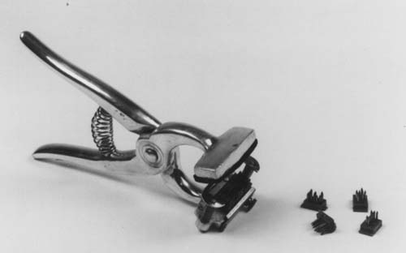
Tattoo Pliers

Slide 19
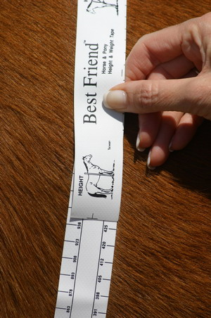
Weight Tape

Slide 20
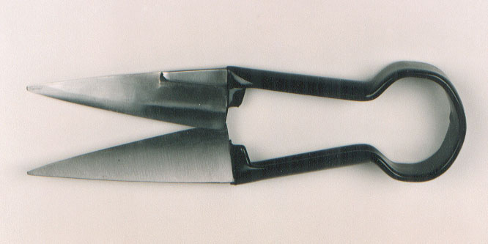
Sheep Shears

Slide 21
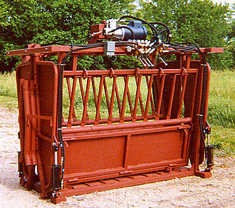
Chute

Slide 22
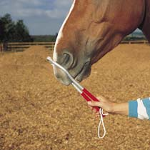
Twitch

Slide 23
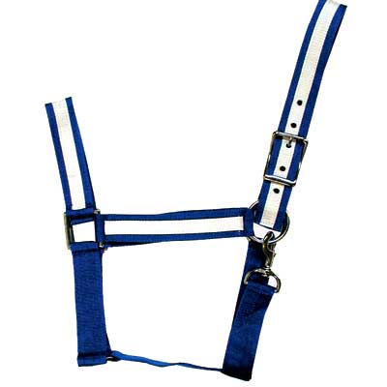
Halter

Slide 24
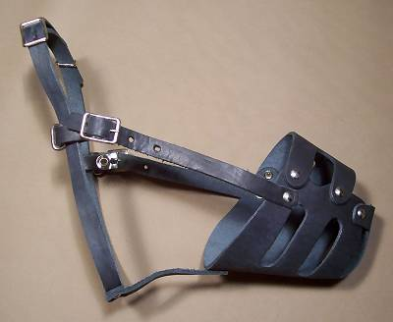
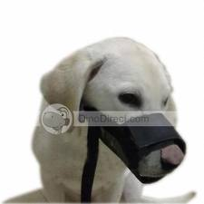
Muzzle

