Slide 1
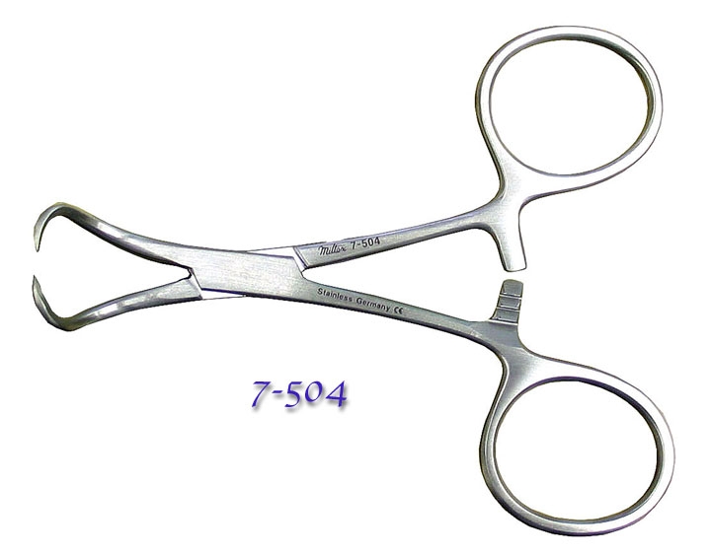
Backhaus Towel Clamp

Slide 2
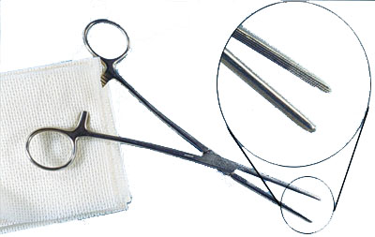
Carmalt Forcep

Slide 3
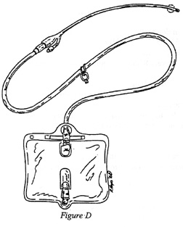
Catheter- Urinary

Slide 4
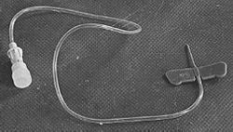
Butterfly Catheter

Slide 5
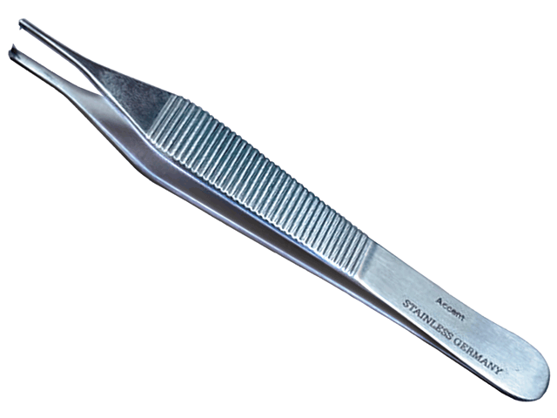
Adison Tissue Forceps

Slide 6
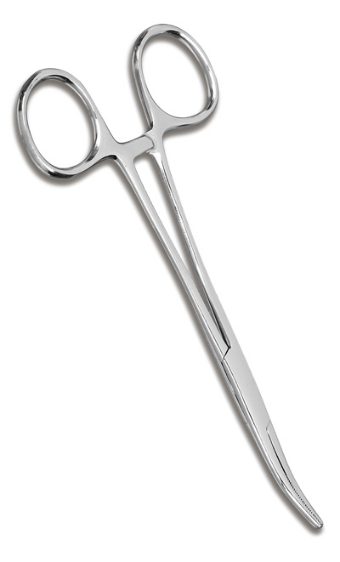
Kelley Forceps

Slide 7
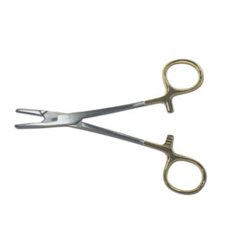
Olsen Hagar Needle Holder

Slide 8
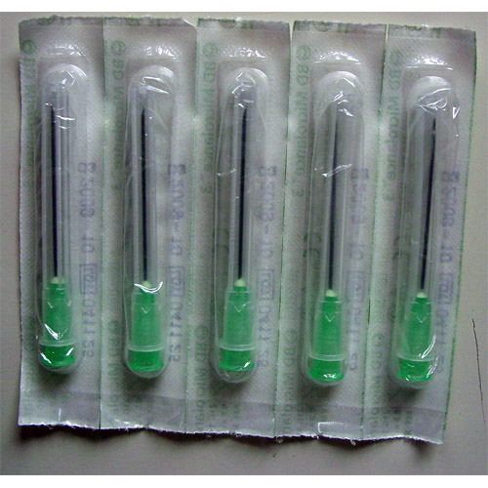
Needles (18, 22, 25 Gauge) Picture is 18 Gauge

Slide 9
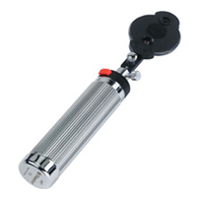
Ophthalmoscope Eye Examination

Slide 10
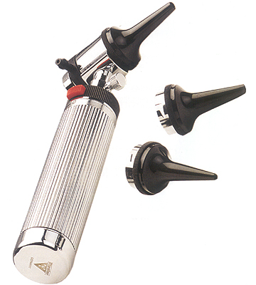
Otoscope with Cones Ear Examination

Slide 11
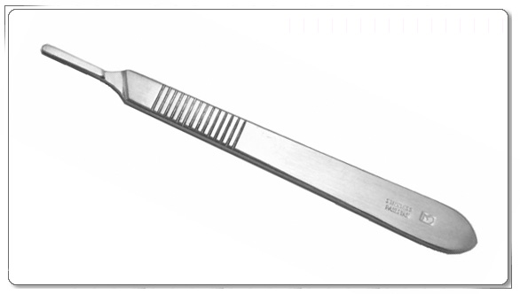
Scalpel Handle

Slide 12
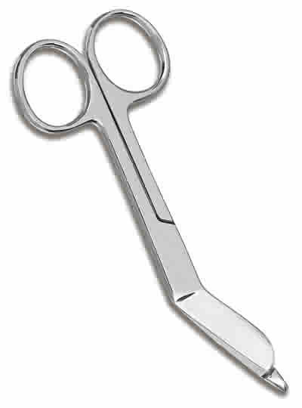
Bandage Scissors

Slide 13
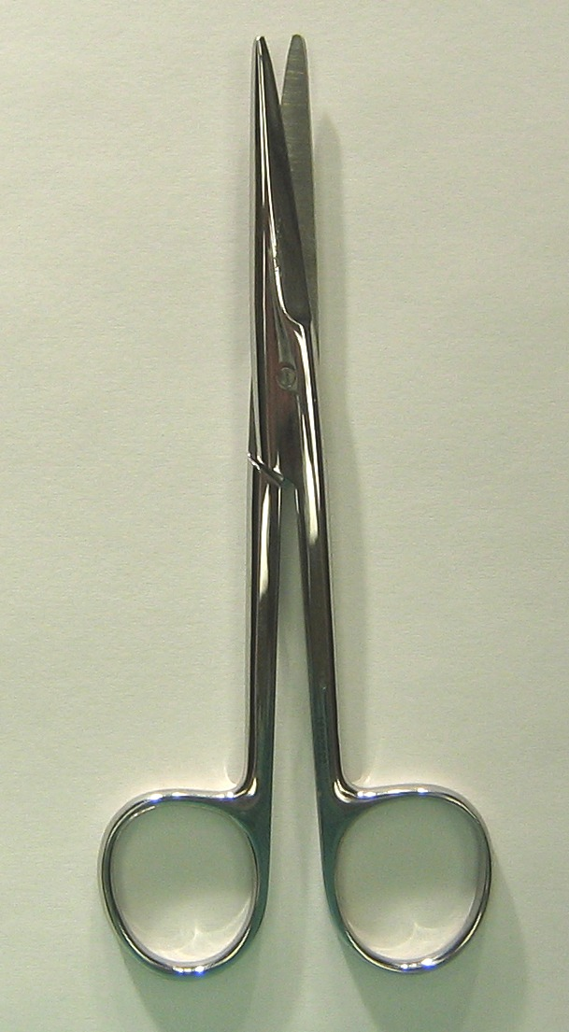
Mayo Scissors

Slide 14
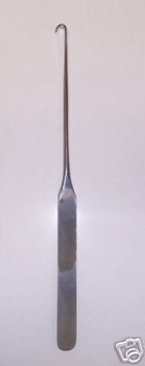
Spay Hook

Slide 15
Stethoscope

Slide 16
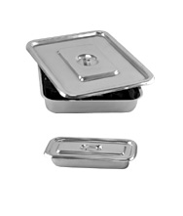
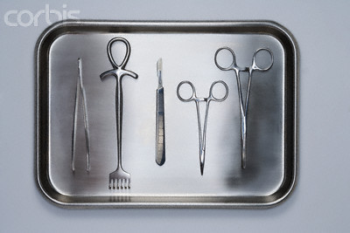
Surgical Tray

Slide 17
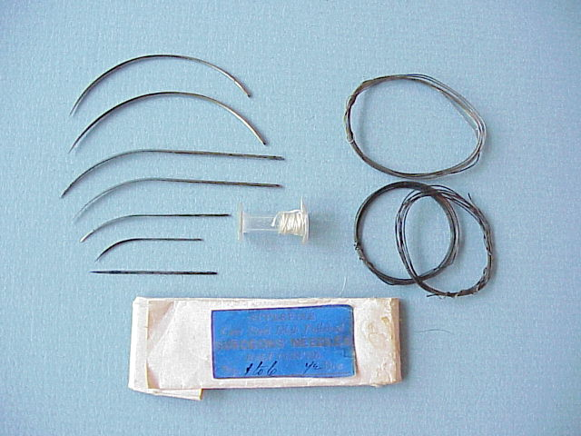
Suture Material

Slide 18
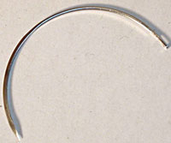
Suture Needle

Slide 19
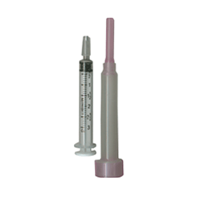
Leur Lock Syringe

Slide 20
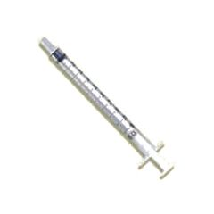
Slip Tip Syringe

Slide 21
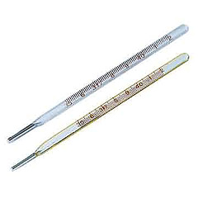
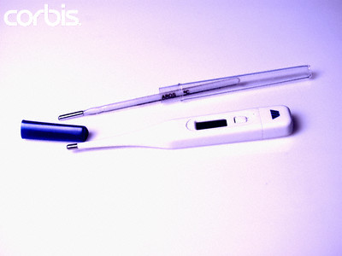
Thermometer

